Slide 1
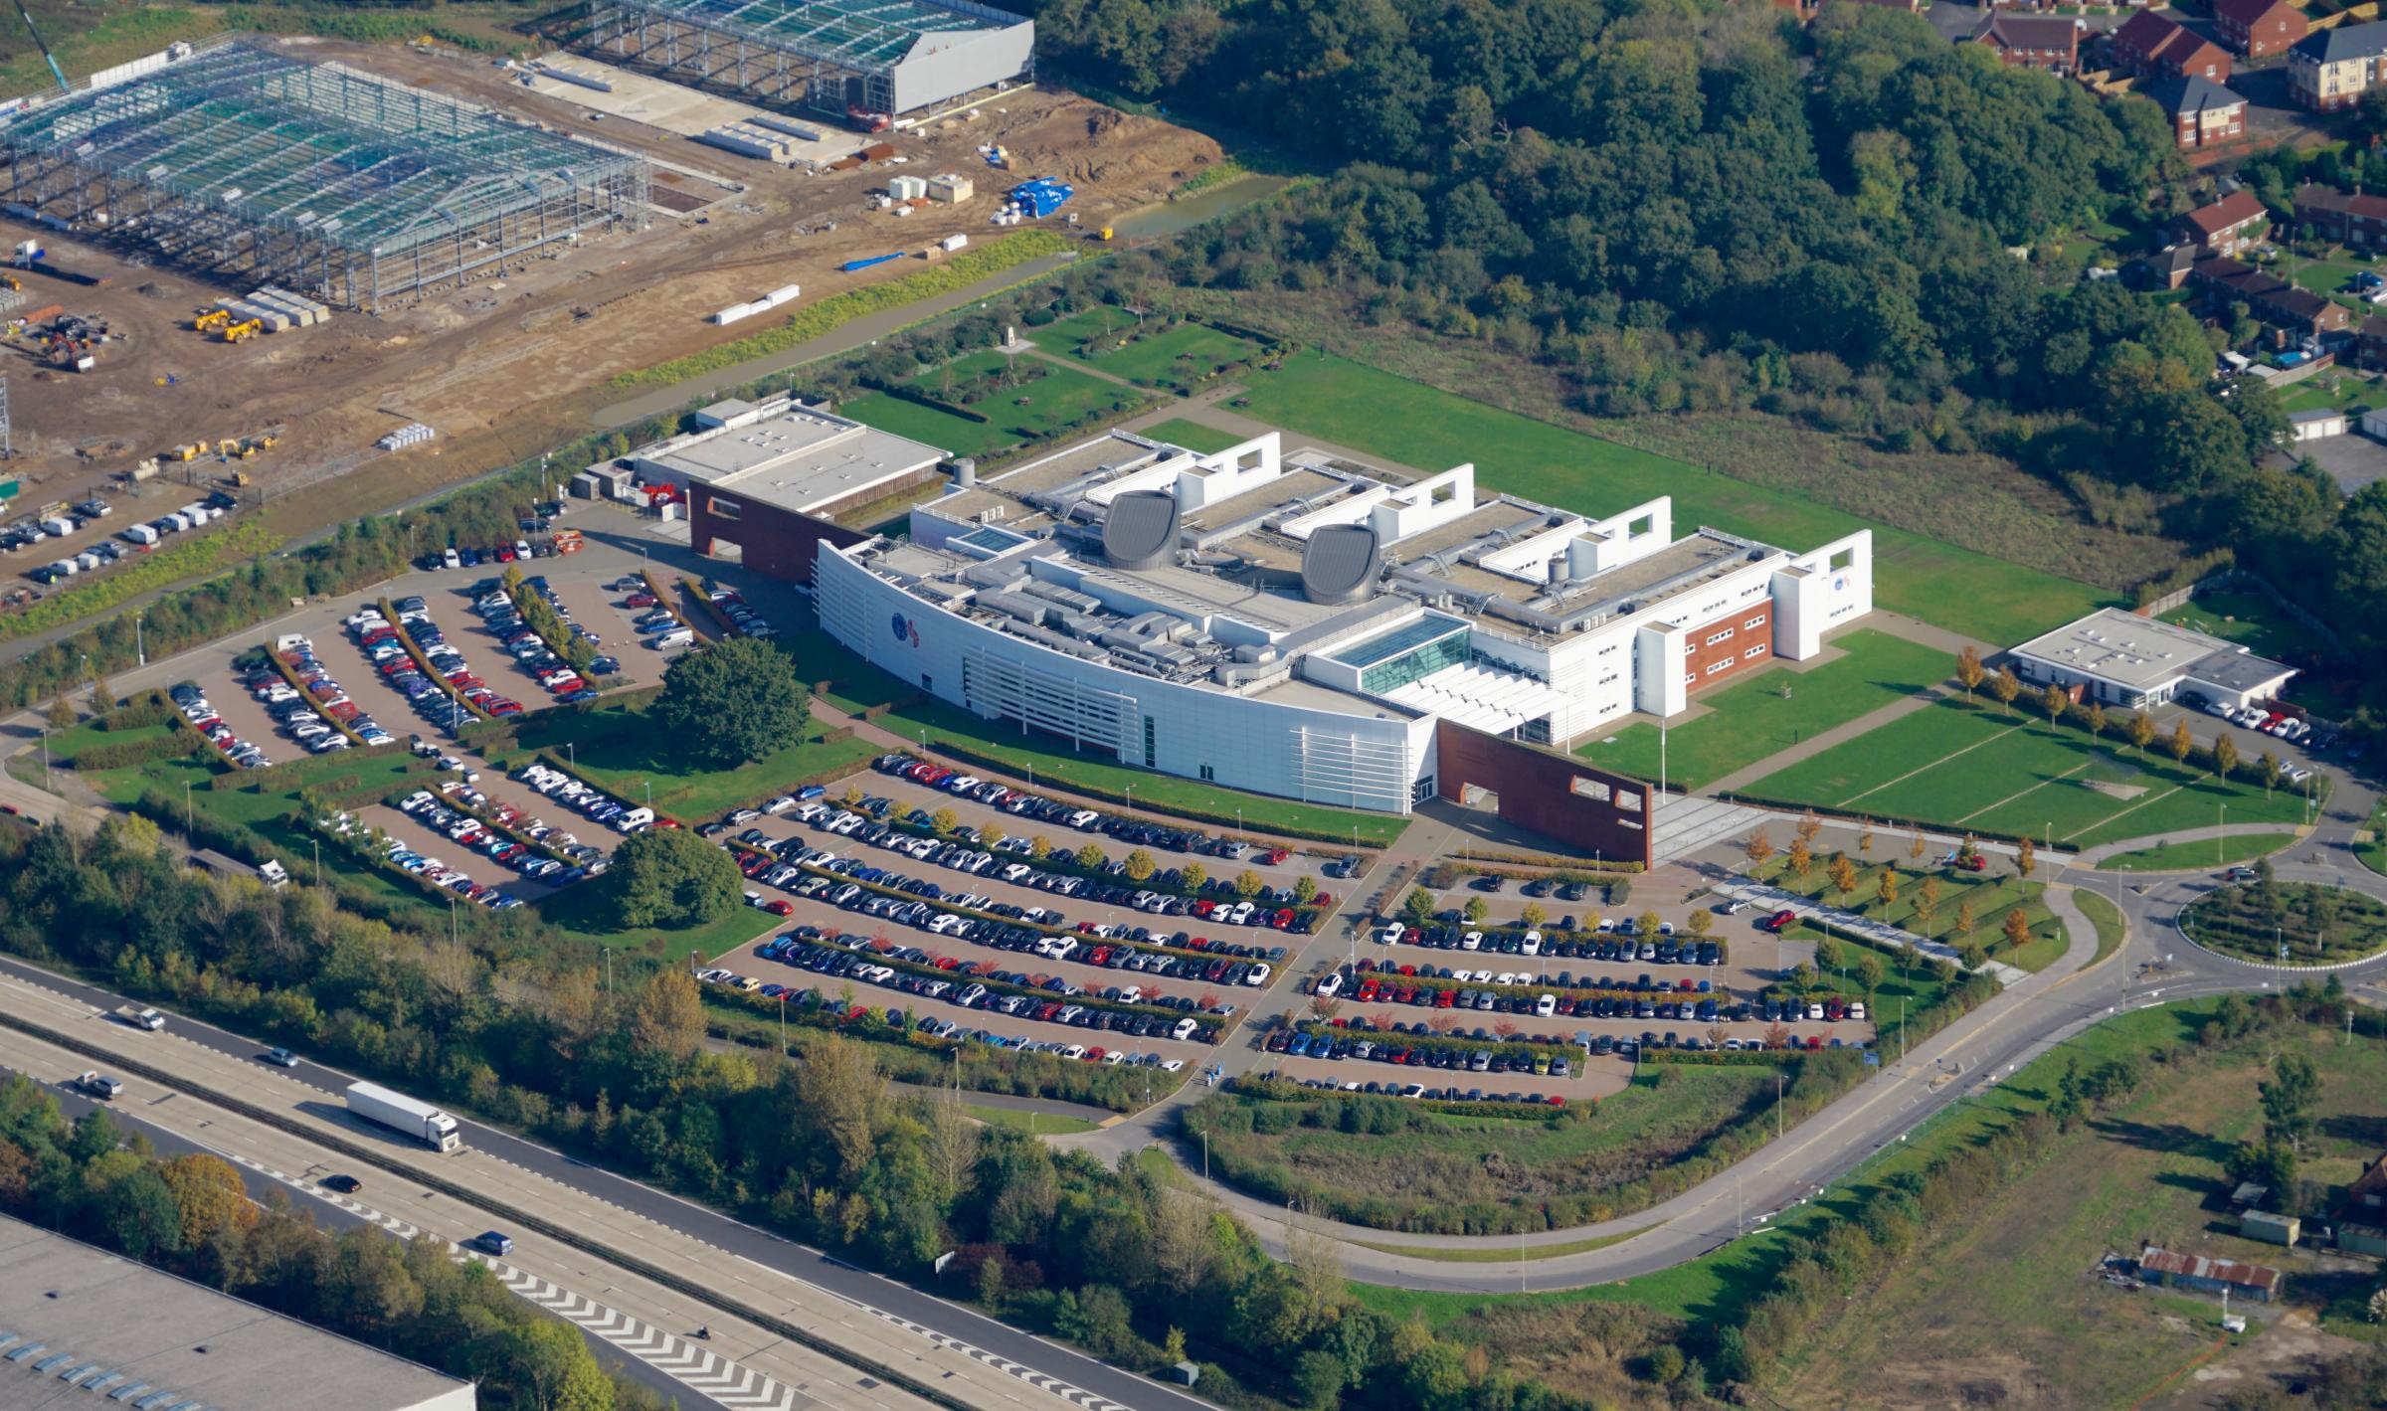
CityGML and GeoPose in glTF Experiment
OGC-Khronos Forum
Steve Smyth, OGC CityGML and GeoPose SWGs
May 2022

Slide 2
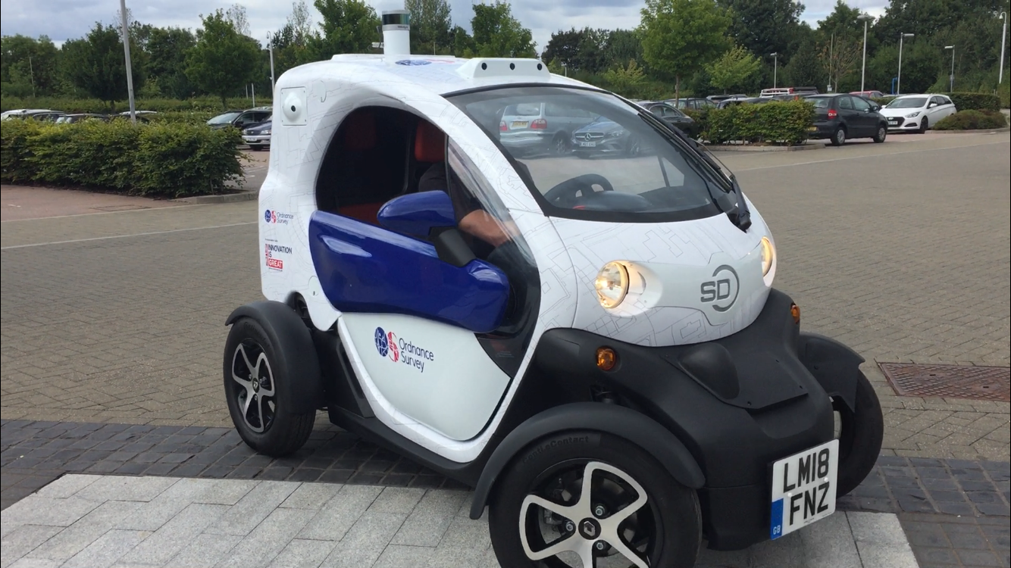
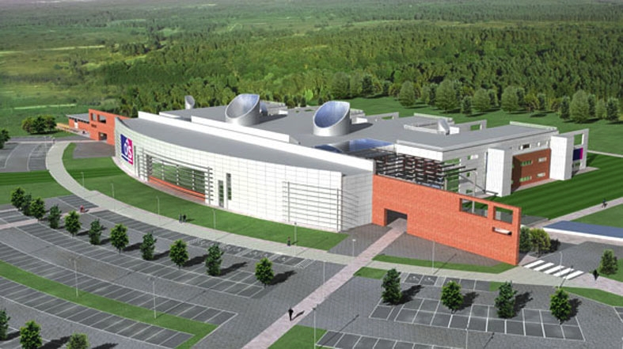
CityGML and GeoPose in glTF Experiment
The GB Ordnance Survey has a “Street Drone” – a modified Renault Twizzy
The Street Drone serves as a testbed for developing technology for navigating, sensing from, and controlling an autonomous road vehicle.
One test carried out near the OS HQ in Southampton UK is the basis of the experiment. Here is a video from the test:
Street Drone run Tue Jul 16 2019

Slide 3
CityGML and GeoPose in glTF Experiment
Goals
To map the space and material properties of the stationary and movable parts of the test area from an OGC CityGML 3.0 GML model to extended glTF and
To use OGC GeoPose 1.0 sequences, both Streams and Series, to animate the moving or mobile features (the drone, other vehicles, people, gates, sun) , also serialized as glTF, as observed during the test run.

Slide 4
CityGML and GeoPose in glTF Experiment
Deliverables
Draft spec for a glTF encoding of CityGML 3.0 – at least Core, Relief, PointCloud, City Furniture, Vegetation, Construction, Transportation, and Building Modules.
An animated instance reproducing the video.
Timeline
Summer 2022
Participation
OGC-Khronos Forum meetings – meet when there is a need.
GitHub.

